Slide 1
algol

Slide 2
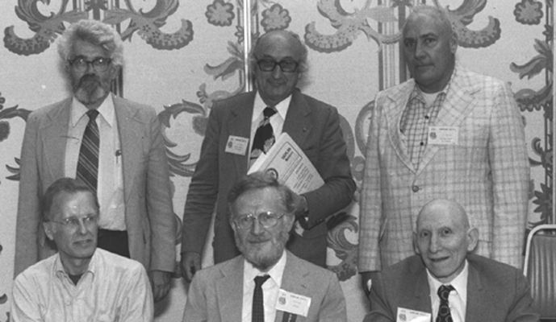
Algol
ALGOL (ALGOrithmic Language) is a family of imperative computer programming languages originally developed in the mid 1950s that greatly influenced many other programming languages.
Introduced by a joint committee of American (ACM) and European (GAMM) experts .
GAMM: Gesellschaft für Angewandte Mathematik und Mechanik ("Society of Applied Mathematics and Mechanics")
ACM: Association for Computing Machinery
Some of the original designers or Algol.
Top row: John McCarthy, Fritz Bauer, Joe Wegstein.
Bottom row: John Backus, Peter Naur, Alan Perlis.

Slide 3
Algol
According to John Backus, the original goals of the original meeting in ETH Zurich were:
To provide a means of communicating numerical methods and other procedures between people
To provide a means of realizing a stated process on a variety of machines.
Original objectives of Algol:
Machine independence
As close as possible to mathematical notation
Usable for the description of algorithms in publications
Easily translatable to machine instructions
Avoid some of the perceived problems with FORTRAN
Language simplicity

Slide 4
Algol
Original contributions of the various versions of Algol:
Code blocks, local variables, static scoping
Compound statement
Structured control statements improved from Fortran (for, do, if, switch)
Recursion
Multidimensional and dynamic arrays
Dynamic memory allocation (stack)
Pass by name, pass by value parameter passing
Nested functions
User-defined data types
Parallelism/concurrency/semaphores
Type casting
Language translation techniques such as syntax-directed translation
First language to be defined using a formal notation (BNF)

Slide 5
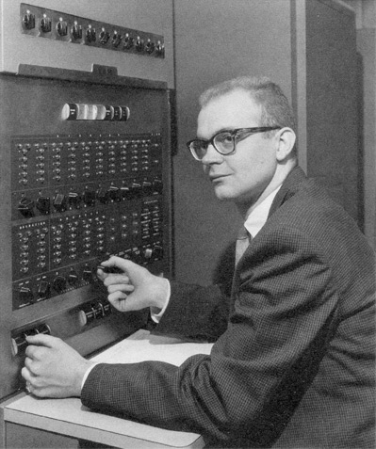
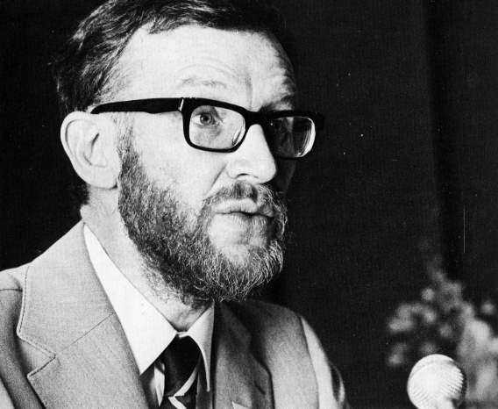
Algol
John Backus developed the Backus Normal Form method of describing programming languages syntax specifically for ALGOL 58.
It was revised and expanded by Peter Naur for ALGOL 60, and at Donald Knuth's suggestion renamed Backus–Naur Form.
Donald Knuth
The Backus-Naur Form has been used ever since in the design of programming languages.
Peter Naur

Slide 6
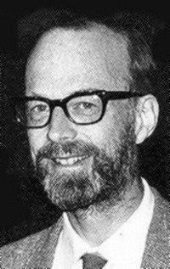
Algol
Algol-58:
First version, originally named IAL: International Algorithmic Language.
Was implemented first in Europe, but met with some resistance in the United States due to the predominance of Fortran at IBM.
Starting in 1959 in Communications of the ACM, Algol was used to represent algorithms, and this for the next 30 years.
Algol-60:
First language to include lexical scoping, pass by value and pass by name, recursion, dynamic arrays.
First language to be standardized (with COBOL)
ALGOL 60 inspired many languages that followed it. C. A. R. Hoare remarked: "Here is a language so far ahead of its time that it was not only an improvement on its predecessors but also on nearly all its successors."
Tony Hoare

Slide 7
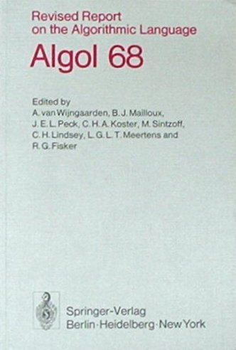

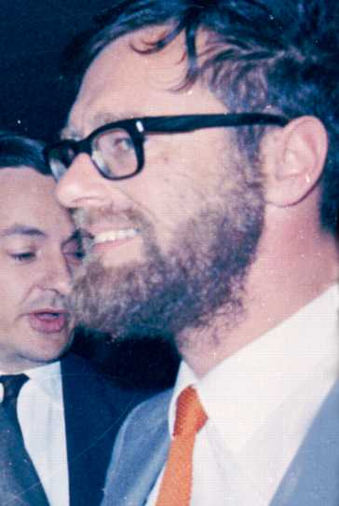
Algol
Algol-68:
Evolution of Algol-60 that incorporated many innovative and important features that became part of many other languages to come.
elaborated types (short, long, loc, heap, reference, etc), type casting, union type.
array slicing
operators
I/O formatting: “transput”
parallel processing
Resulted in a much more complex language, which eventually was detrimental to the success of Algol, as reported by C.A.R. Hoare, Edsger Dijkstra and Nicklaus Wirth.
Algol-W (1966):
Nicklaus Wirth early development of Pascal.
Algol 68 Revised Report
Nicklaus Wirth
Edsger Dijkstra

Slide 8
Algol vs. fortran

Slide 9
Algol vs. Fortran
Algol introduced many more innovative features than Fortran.
Yet, Fortran met with more success than Algol.
But did it, really?
Success is very much subjective and multifaceted.
If we consider commercial success, Fortran was as huge success.
However, if we consider influential success, Algol was much more successful.
To make a parallel with spoken languages:
Latin is not used anymore.
However, many languages used now are based on Latin.
So, Latin itself is “dead”, but its successors are striving.

Slide 10
Algol vs. Fortran
Some reasons why Algol did not become more popular than Fortran:
Fortran was already established as Algol was under development.
IBM initially supported Algol, but later stopped supporting it.
Language adoption follows “snowball effect”.
Algol had more syntax features, with the following consequences:
Harder to learn than Fortran.
Compilers were much more complex to develop. Advanced compiler design methods and tools were not available at the time.
Complexity led to less efficient generated machine code.

Slide 11
Algol vs. Fortran
Some reasons why Algol did not become more popular than Fortran:
Fortran was seen as a stable, practical and very efficient tool.
Algol was introducing more and more advanced “intellectual” features, whose implementation was problematic for performance.
Fortran was developed by people who were all focused on the practical aspects of its use, and concentrated on making a stable version of Fortran work on the new hardware as it became available.
Algol was developed by scientists that were concerned with the theoretical definition of the language, developing new translation techniques, and exploring new avenues for programming. These endeavors were not seen as immediately practical by many computer users.

Slide 12
Algol vs. Fortran
Some reasons why Algol was more influential than Fortran
Algol was a landmark in the development of programming language theory and implementation, including the Backus-Naur form, syntax-directed translation, and dynamic memory allocation.
Algol was a direct descendent of Pascal, which soon became one of the main language used to teach programming all over the world.
Another direct descendent of Algol was Ada, which was adopted as mandatory language by the United States Department of Defence.
Algol was used for more than 30 years in scientific publications for the expression of algorithms.

Slide 13
Algol vs. Fortran
Most influential original contributions of Algol:
User-defined data structures
Reference types
Compound statement, code block, scoping
Concurrency
Type casting
Dynamic arrays
Operator overloading
All of these language features are used in modern programming languages.

Slide 14
Pl/i

Slide 15
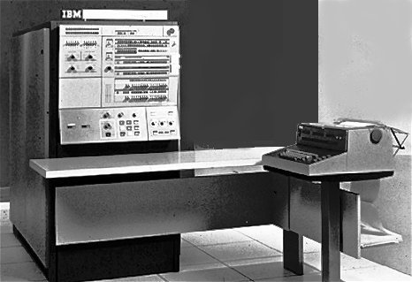
PL/I
With Fortran and Cobol, there were two distinct “kinds” of programmers. Fortran emphasized floating point arithmetic, arrays, procedures, fast computation. Cobol emphasized decimal arithmetic, fast asynchronous input/output, string handling, efficient search/sort routines.
More and more, there came a need for all these features to be incorporated in a single language.
When IBM designed the famous IBM360 computer, it saw the opportunity to design a new general-purpose language designed specifically for it.
This language was named PL/I (Programming Language 1). It was originally developed in 1964-1966.
IBM 360

Slide 16
PL/I
Goals of PL/I:
Provide features of Fortran, augmented with the capacities of Cobol.
Clarity of language.
Incorporating current programming languages innovations.
Performance of compiled code competitive with that of Fortran.
Extensibility to new hardware and other application areas.
Improve programming productivity - transferring effort from programmer to compiler.
Machine and operating system independence.

Slide 17
PL/I
This created a language with very numerous features and requirements, including many innovative ones:
Reference data types
User-defined data types
Concurrency
Dynamic arrays
Auto-correcting compiler
String handling
Machine independence
Efficiency
Exception handling
I/O control system
Report-generation
Recursion

Slide 18
PL/I
The first attempts at meeting these goals was mostly based on an evolution of Fortran (name Fortran VI).
It was quickly realised to be infeasible, and a new language was designed and named NPL (New Programming Language), defined in 1964, implemented in the UK IBM Hursley Laboratory, then renamed PL/I in 1965.
Although the idea of creating a general-purpose language was a noble idea, the PL/I experience now serves as an example as to the difficulties involved in designing a general-purpose language.
Though the language was easy to learn and use, implementing a PL/I compiler was difficult and time-consuming.

Slide 19
PL/I
It has been claimed that a PL/I compiler was two to four times as large as comparable Fortran or COBOL compilers, and also that much slower - fortunately offset by gains in programmer productivity. This was anticipated in IBM before the first compilers were written.
The effort needed to produce good and efficient object code was underestimated during the initial design of the language.
It contained many rarely used features, such as multitasking and exception handling, which added cost and complexity to the compiler, for features seldom used.

Slide 20
PL/I
On the positive side, full support for pointers to all data types (including pointers to structures), recursion, multitasking, string handling, and extensive built-in functions PL/I was indeed quite a leap forward compared to the programming languages of its time.
However, these were not enough to convince a majority of programmers or companies/organizations to switch to PL/I.
Despite all this, PL/I was both a significant advance in programming languages and a good commercial and academic success.

Slide 21
Pascal

Slide 22
Pascal
Pascal is a very influential imperative and procedural programming language, designed in 1968-1969 and published in 1970 by Niklaus Wirth.
Small and efficient language intended to encourage good programming practices using structured programming and data structuring.
Nicklaus Wirth
Pascal is based on the ALGOL-60 programming language and named in honor of the French mathematician and philosopher Blaise Pascal.

Slide 23
Pascal
Pascal, in its original form, is a purely procedural language and includes the traditional array of ALGOL-60 control structures.
Pascal also has many data structuring facilities and other abstractions which were not included in the original ALGOL 60, such as:
user-defined type definitions
records
case statement
pointers
enumerations
sets
Such constructs were inspired from Simula 67, ALGOL 68, and Wirth and Hoare’s ALGOL W.

Slide 24
Pascal
Before, and leading up to Pascal, Wirth developed the language Euler, followed by Algol-W.
Wirth subsequently developed the Modula-2 and Oberon, languages similar to Pascal.
Initially, Pascal was largely, but not exclusively, intended to teach students structured programming, due to a great combination of simplicity and expressivity.
Generations of students worldwide have used Pascal as an introductory language in undergraduate courses, lasting from ~1975 to ~1995.
A derivative known as Object Pascal was designed for object oriented programming. Object Pascal is the main programming language used in the Delphi programming environment.

Slide 25
simula

Slide 26
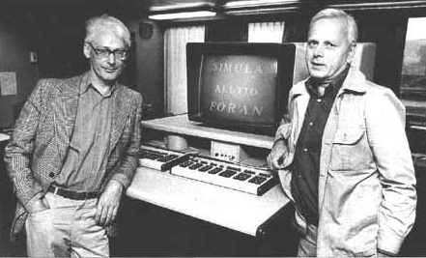
Simula
Simula was developed in the 1960s at the Norwegian Computing Center in Oslo, by Ole-Johan Dahl and Kristen Nygaard.
Syntactically, it is a superset of Algol 60.
Ole-Johan Dahl and Kristen Nygaard
Simula 67 introduced objects, classes, subclasses, virtual methods, coroutines, discrete event simulation, and featured garbage collection.
Simula is considered the first object-oriented programming language.

Slide 27
Simula
As its name implies, Simula was designed for doing simulation.
Simulation systems are modelled by a series of state changes that occur in parallel through the interaction of the elements of the system as they compete for restricted system resources.
Each type of element of the system is composed of its internal state, as well as a set of procedures that define its own behaviour.
Elements interact with one another as a system by calling some of the other elements’ procedures.
This is the baseline of what we now call object-oriented programming.

Slide 28
Simula
Simula was based on Algol 60 with the addition of the concept of class.
Simula allowed to declare classes of objects, create instances of these classes, name the instances, and even form a hierarchical structure of class declarations.
Simula was designed solely as a language to be used for simulations. However, in retrospect, its concept can clearly be used as a general-purpose language.
The impact of Simula on subsequent languages is great but little recognized, as most people think that object-oriented programming is a relatively new concept.

Slide 29
ISWIM

Slide 30
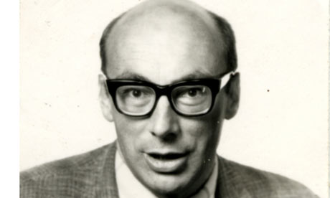
ISWIM
ISWIM is an abstract computer programming language devised by Peter J. Landin and first described in his article, The Next 700 Programming Languages, published in the Communications of the ACM in 1966.
Peter Landin
The acronym stands for "If you See What I Mean".
Although not implemented, it has proved very influential in the development of subsequent programming languages, especially functional programming languages such as SASL, Miranda, ML, Haskell and their successors.

Slide 31
ISWIM
Landin was inspired by LISP’s relationship with Lambda Calculus for the creation of ISWIM.
An ISWIM program is a single expression qualified by 'where' clauses (auxiliary definitions including equations among variables), conditional expressions and function definitions. ‘Where' clauses are now used widely in functional and declarative programming languages.
Peter Landin was also involved in the creation of Algol.
In his Turing Award lecture, Tony Hoare credited John Backus, Edsger Dijkstra and Peter Landin with introducing him to Algol and recursion, which led him to invent his famous Quicksort algorithm.

Slide 32
C

Slide 33
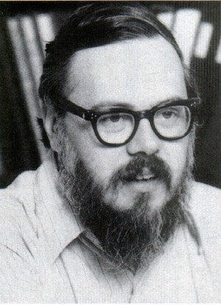
C
C is a general-purpose programming language developed between 1969 and 1973 by Dennis Ritchie at the Bell Telephone Laboratories for use with the Unix operating system.
Although C was designed for implementing system software, it is also widely used for developing portable application software.
Dennis Ritchie
C has become one of the most popular programming languages. It is widely used on many different software platforms, and there are few computer architectures for which a C compiler does not exist. C has greatly influenced many other programming languages, most notably C++, which originally began as an extension to C.

Slide 34
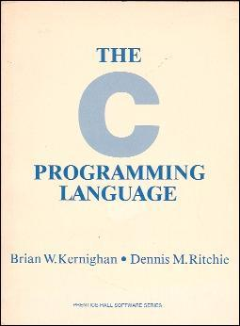
C
C was influenced by the languages BCPL and B (systems languages), who were influenced by Algol and Fortran.
C was originally designed in 1969-1972 with the following goals in mind:
to be compiled using a relatively straightforward compiler
to provide low-level access to memory
to provide language constructs that map efficiently to machine instructions
to require minimal run-time support
In 1977-1979, portability emerged when portability of the Unix operating system was being demonstrated.
In 1978, the famous book The C Programming Language was published, written by Brian Kernigan and Dennis Ritchie.

Slide 35
C
The Unix operating system was and is still widely used on many computers.
All Unix operating systems included a C compiler and was itself developed using the C language.
Thus, C was readily available on virtually all machines and was proven to be powerful enough to create an operating system.
Thus, many programmers started using it, creating an ever-growing code base and libraries and tools written in C.
C is a typical example of “snowball-effect” programming language popularity.

Slide 36
C
C exhibits the following specific characteristics:
variables may be hidden in nested blocks
partially weak typing
low-level access to computer memory using typed pointers
function and data pointers supporting ad hoc run-time polymorphism
array indexing as a secondary notion, defined in terms of pointer arithmetic
a preprocessor for macro definition, source code file inclusion, and conditional compilation
complex functionality such as I/O, string manipulation, and mathematical functions consistently delegated to library routines

Slide 37
C
C does not have some features that are available in some other programming languages:
No direct assignment of arrays or strings
No automatic garbage collection
No requirement for bounds checking of arrays
No operations on whole arrays
No syntax for ranges, such as the A..B notation used in several languages
No functions as parameters (only function and variable pointers)
No exception handling
Only rudimentary support for modular programming
No compile-time polymorphism
Only rudimentary support for generic programming (using macros)
Limited support for encapsulation
No native support for multithreading and networking

Slide 38
C
At the time of its creation, C was useful for many applications that had formerly been coded in assembly language.
Despite its low-level programming capabilities, the language was designed to encourage machine-independent programming.
A standards-compliant and portably written C program can be compiled for a very wide variety of computer platforms and operating systems with little or no change to its source code.
C has become available on virtually any computing platform: from embedded microcontrollers to supercomputers.

Slide 39
smalltalk

Slide 40
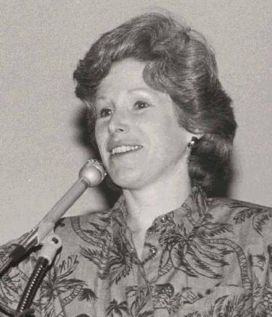
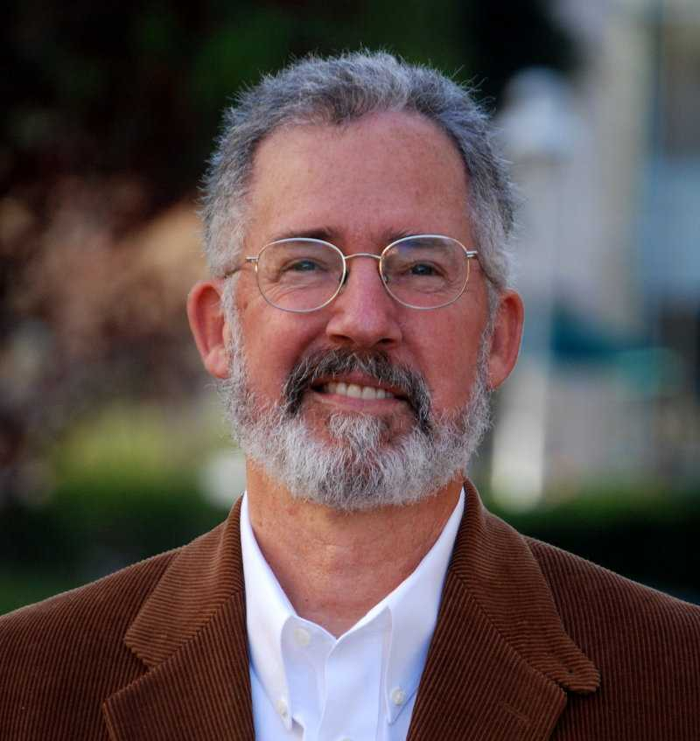

Smalltalk
Smalltalk is an object-oriented, dynamically typed, reflective programming language.
It was designed and created in part for educational use at the Learning Research Group of Xerox PARC by Alan Kay, Dan Ingalls, Adele Goldberg, Ted Kaehler, Scott Wallace, and others during the 1970s.
Adele Goldberg
Alan Kay
Dan Ingalls

Slide 41
Smalltalk
Smalltalk emerged with Alan Kay’s great “Dynabook” insight, predicting the creation of desktop and portable computers, and their availability to everyone.
Kay envisioned that such computers would need to have very intuitive graphics-oriented human-interface capabilities.
Smalltalk was a programming environment developed following this vision.
The first operational computer resulting from Kay’s vision was the Xerox Alto.

Slide 42
Smalltalk
After the preliminary research versions Smalltalk-71, Smalltalk-72 and Smalltalk-76, Smalltalk was publicly released as Smalltalk-80 and has been widely used since.
One of the early versions, Smalltalk-76, was one of the first programming languages to be implemented along with a development environment featuring most of the now familiar tools, including a class library code browser/editor.
Smalltalk-like languages are in continuing active development, and have gathered loyal communities of users.

Slide 43
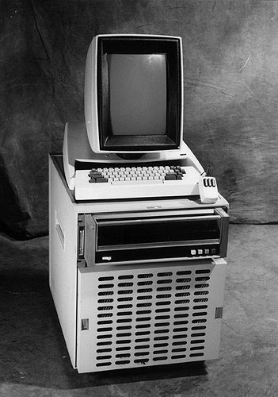
Smalltalk
Smalltalk was the first programming environment based on a WIMP system. WIMP interaction was developed at Xerox PARC with the Xerox Alto in 1973 :
A window runs a self-contained program, isolated from other programs that run at the same time in other windows.
An icon acts as a shortcut to an action the computer performs.
A menu is a selection system that allows the user to execute programs or tasks associated with a window or icon.
The pointer is an onscreen symbol that represents movement of a physical device that the user controls to select windows, icons, and menu items.
Xerox Alto

Slide 44
Smalltalk
In Smalltalk, everything is an object: from integer constants to entire software systems.
All computing in Smalltalk is done using the same principle: message passing.
A Smalltalk object is a data structure holding a state (through object composition), and containing methods that can be used to reply to messages sent to the object.
A message is sent from an object sent to another object, and a reply to a message is itself also and object.
The main difference with a procedure call is that a message is sent to a data object, who then decides with which method to reply to the received message.
Message passing can be implemented asynchronously.
The message passing model developed for Smalltalk was an inspiration for the development of the Actor Model of concurrent computing.

Slide 45
Smalltalk
A Smalltalk object can do exactly three things:
Hold state (references to other objects).
Receive a message from itself or another object.
In the course of processing a message, send messages to itself or another object.
The state an object holds is always private to that object.
Other objects can query or change that state only by sending requests (messages) to the object to do so.
Alan Kay has commented that despite the attention given to objects, messaging is the most important concept in Smalltalk.

Slide 46
Smalltalk
Smalltalk-80 added metaclasses, to help maintain the "everything is an object" paradigm by associating properties and behavior with individual classes.
In this view, all values are objects, even the classes themselves are objects. Each class is an instance of the metaclass of that class. Metaclasses in turn are also objects, and are all instances of a class called Metaclass. Code blocks are also objects.
This makes Smalltalk one of the only “pure” object-oriented languages.

Slide 47
Smalltalk
Smalltalk programs are usually compiled to bytecode, which is then interpreted by a virtual machine or dynamically translated into machine-native code as in just-in-time compilation.
Smalltalk has influenced the wider world of computer programming in four main areas.
It inspired the syntax and semantics of other computer programming languages.
It was a prototype for a model of computation known as message passing, who inspired the Actor Model of concurrent computing.
Its WIMP GUI inspired the windowing environments of personal computers, so much so that the windows of the first Macintosh desktop looked almost identical to the windows of Smalltalk-80.
Its integrated development environment was the model for a generation of visual programming tools that look like Smalltalk's code browsers and debuggers.
The architecture of the Smalltalk programming environment developed the Model-View-Controller architecture widely used nowadays in many applications.

Slide 48
Smalltalk
Smalltalk-80 is a totally reflective system, implemented in Smalltalk-80 itself. Smalltalk-80 provides both structural and computational reflection.
Smalltalk is a structurally reflective system whose structure is defined by Smalltalk-80 objects.
The classes and methods that define the system are themselves objects and fully part of the system that they help define.
The Smalltalk compiler compiles textual source code into method objects, typically instances of the CompiledMethod class.
These get added to classes by storing them in a class's method dictionary. The part of the class hierarchy that defines classes can add new classes to the system. The system is extended by running Smalltalk-80 code that creates or defines classes and methods. In this way a Smalltalk-80 system is a "living" system, carrying around the ability to extend itself at run time.

Slide 49
Smalltalk
Since the classes are themselves objects, they can be asked questions such as "what methods do you implement?" or "what instance variables do you define?".
So objects can easily be inspected, copied, (de)serialized and so on with generic code that applies to any object in the system.
Smalltalk-80 also provides computational reflection, the ability to observe the computational state of the system.
In languages derived from the original Smalltalk-80 the current activation of a method is accessible as an object named via a keyword: thisContext. By sending messages to thisContext a method activation can ask questions like "who sent this message to me".
These facilities make it possible to implement co-routines or Prolog-like back-tracking without modifying the virtual machine.

Slide 50
Smalltalk
When an object is sent a message that it does not implement, the virtual machine sends the object the doesNotUnderstand message with a reification of the message as an argument.
The message (another object, an instance of Message) contains the selector of the message and an Array of its arguments. In an interactive Smalltalk system the default implementation of doesNotUnderstand is one that opens an error window reporting the error to the user.
Through this and the reflective facilities the user can examine the context in which the error occurred, redefine the offending code, and continue, all within the system, using Smalltalk-80's reflective facilities.

